Slide 1
Model United Nations Italymun workshops
Day 2
Cicognini High School
Notes:
90601 CRN

Slide 2
Today’s Outline
Roll Call
Executing Your Research Plan
Writing Speeches
Delivering Speeches
Reflection and Review
Notes:
90601 CRN

Slide 3
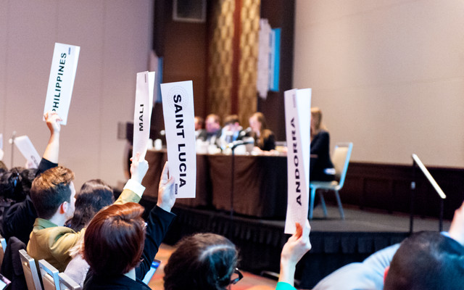
Roll Call Module
What is Roll Call?
Signifies that you are in attendance
Stipulates how you will vote (present, present and voting)
How should I respond during Roll Call?
By raising your paper placard and saying that you are “present” or “present and voting”
Present means you can vote yes, no, abstain
Present and voting means you can only vote yes or no
Notes:
90601 CRN

Slide 4
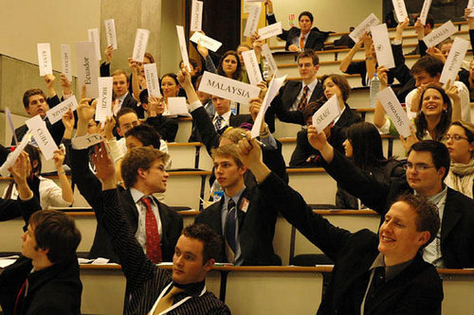
Roll Call Module
When does it occur?
At the beginning of each committee session, voting bloc
Roll Call example
All students participate in Roll Call
Notes:
90601 CRN

Slide 5
Research Plan
You want to know the answers to 5 basic questions:
What is the topic/problem?
How has it been addressed in the past?
What is your country’s stance on this problem and its potential solutions?
What types of solutions are you able to mandate or propose as a member of your UN committee
What are some potential solutions to the problem?
Notes:
90601 CRN

Slide 6
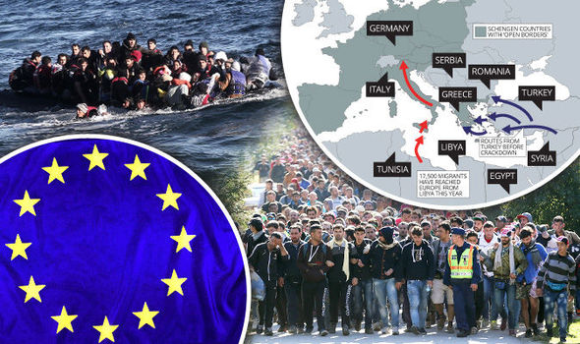
Research Plan
Question 1 - Topic
Topic’s description and history
What is it?
Why does it matter?
What are its causes?
What does it affect?
Who are the major players and stakeholders?
Notes:
90601 CRN

Slide 7
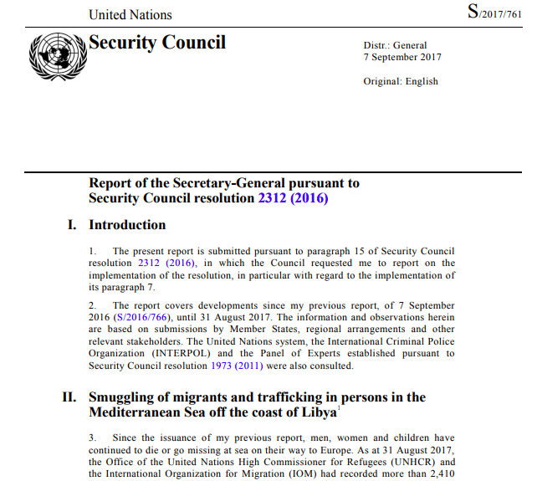
Research Plan
Question 2 – Topic’s Previous Frameworks, Reports, Solutions
Committee’s history, role, mandate in addressing issues
Topic’s previous frameworks/resolutions relating to its scope, primary elements/causes, proposed solutions of paths forward
Various levels: supranational, regional, country, and non-governmental level
Notes:
90601 CRN

Slide 8
Research Plan
Question 3 – Country’s Position on Topic and Frameworks
Country’s position on your topic, political structure, administration, key policymakers, economy, primary partners, interest in the topic
Question 4 – Committee’s mandate
Committee’s history, role, mandate in addressing the topic
SC Mandate on Migration topic - to promote rule of law, monitor the protection of human rights within Libya, and ensure a stable transition to democracy as well as control unsecured arms to prevent their misuse and trafficking.
Notes:
90601 CRN

Slide 10
Research Plan
Question 5 – New Solutions to the Topic
Brainstorm potential solutions or ways to address your topic/issue/problem
Authorizing the use of force to restore peace and security
Empowering a monitoring regime
Notes:
90601 CRN

Slide 11
Creating the Research Plan
Please take out the research handout by Joseph Scollo on your computers
Review document with students
Please open your committee’s background guide
Please open a Word or Google Doc to take notes and to create your research plan
Notes:
90601 CRN

Slide 12
Executing Research Plan Module
Activity
Assign students a country to represent
Articulate resources to research each part of outline
Create a document listing the 5 questions and all information relevant that answers them
Feedback
Advisor circulates and offer help and feedback
Notes:
90601 CRN

Slide 13
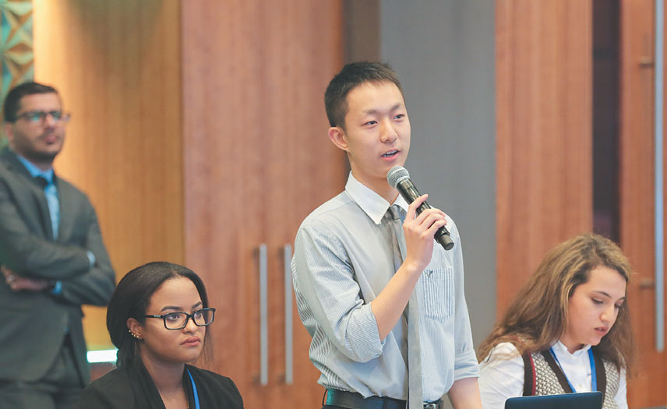
Speech Writing Module
MUN Speeches are 60 seconds to 90 seconds
Important things to note
Make a clear point
Provide a story/narrative
Provide rational, logical reasoning
Provide evidence
Use transitions
Provide a call to action
Notes:
90601 CRN

Slide 14
Speech Writing Module
3 Elements of Speeches
Structure – intro, story frame, thesis, rationale, evidence, transitions, tie back, call to action
Content – that which fills out the structure
Delivery – vocals, body language, eye contact
2 Types of Speeches for MUN
Topic Importance speech
Problem solution speech
Notes:
90601 CRN

Slide 15
Speech Writing Module
Topic Importance Speech Template
Intro story frame of your problem/topic
Transition
Thesis/Main Point – statement of topic importance
Body
Reason/claim why topic is important
Elaboration
Evidence supporting claim
Transition
Close
Restatement of thesis
Refer back to story frame
Call to action
Notes:
90601 CRN

Slide 16
Topic Importance Speech Example
“I’ve seen ​terrible​ things. ​Terrible​. I just remember tanks everywhere and I could constantly hear the sounds of rifles.”
These memories are told by a ​seven-year-old​ boy named Bassam and describes most of his childhood. After fleeing his country and losing his mother ​and ​father, Bassam struggles with hunger, thirst, and a no place to call home. Cases like this are why safeguarding the health of refugee children and youth are so important.
Forced displacement increases the risk of refugee children and youth acquiring diseases - physically and mentally. According to UNICEF, there have been more than 26,000 migrant deaths since 2014, yet the number of children among them is not known. The fact that this information is not readily available is truly disturbing. Do children not matter?
Honorable Chair and fellow delegates, in this day and age, the health of children - especially vulnerable children like Bassam - is the most​important thing we can do for future generations. These children are our future. Thus, it is critical that our global body works toward a safe and prosperous future for these children.
There are many ways in which families, health care providers, governments, and leaders can build upon the strengths of children and families to help support the healthy adjustment of refugee youth. It is critical that we come together as the United Nations to address this problem so that stories like that of Bassam are no longer the norm.
Notes:
90601 CRN

Slide 17
Speech Writing Module
Activity
Assign students write a topic importance speech
Topic: Addressing the impact of climate change
From your country’s point of view
Feedback
Advisor circulates and offer help and feedback
Notes:
90601 CRN

Slide 18
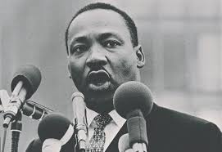
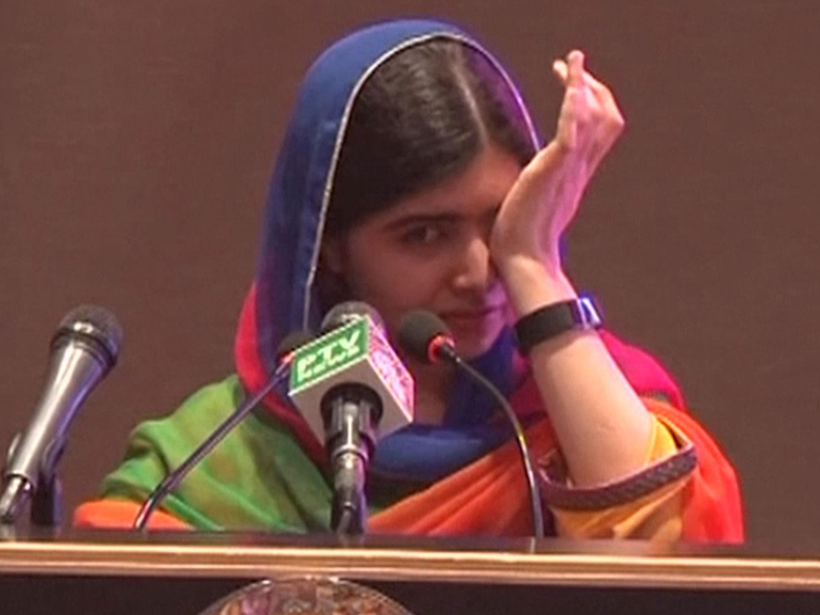
Speech Delivery Module
Important things to focus on
Eye contact
Body position
Body posture
Tone
Volume variation
Projection
Pausing
Stressing particular words
Speed variation
Conviction and belief
Notes:
90601 CRN

Slide 19
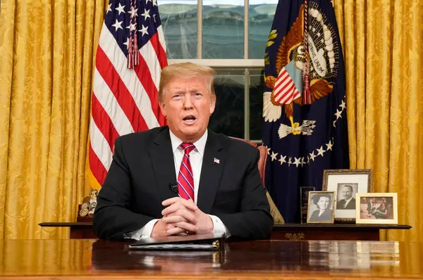
Speech Delivery Module
Important things NOT to do
Looking down at speech
Slouching
Tone does not match words
Monotone throughout
Same volume throughout
Inside voices, whispering
Same speech throughout
Too fast
No conviction, belief
Notes:
90601 CRN

Slide 20
Bad Speech Example – Trump on the Wall and the Shutdown
https://www.youtube.com/watch?v=pzA69MZHPhU
Notes:
90601 CRN

Slide 21
Speech Delivery Module
Activity:
Students give speeches in speech pods
Feedback:
UNH advisor circulates and offers feedback
Activity:
Students revise speeches
Students give speeches in front of class
Feedback: UNH advisors offer feedback
Notes:
90601 CRN

Slide 22
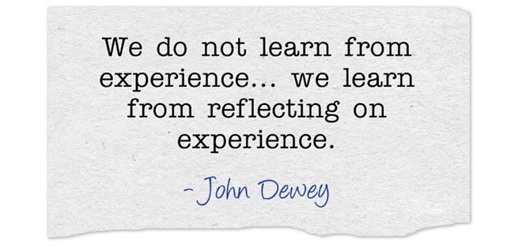
Reflection
What did you learn today?
Do you feel more comfortable with MUN now? Elaborate?
Is there anything you would like me to clarify?
Notes:
90601 CRN

