Slide 1
Model United Nations italymun workshops
Day 3
Cicognini High School
Notes:
90601 CRN

Slide 2
Today’s Outline
Motioning
Debating
Moderated Caucuses
Working Papers
Reflection and Review
Notes:
90601 CRN

Slide 3
Motioning Module
What are Motions?
Various procedural actions delegates can take during formal session to shape the course of the committee meeting;
What are some motions?
Closing Debate
Suspension of the Meeting
Moderated Caucus
Closing the Speaker’s List
Adopting by Acclamation
Changing the Speaker’s Time
Point of Information
Notes:
90601 CRN

Slide 4
Motioning Module
How should I respond during Roll Call?
Raising placard and only after being called on by the Chair articulate your motion
China moves for a 30 minute suspension of the meeting
Greece moves to close the speaker’s list
Mexico moves for a 15 minute moderated caucus on the topic of Carbon Taxes with a speaker’s time of 2 minutes
When does it occur?
During formal session
Activity – students practice motions
Notes:
90601 CRN

Slide 5
Debating Module
Practicing extemporaneous debating/speaking skills
Important things to note
Be clear
Be rational/reason-giving
Be logical
Offer evidence to support your claims
Listen
Be assertive
Be confident
Notes:
90601 CRN

Slide 6
Debating Module
Activity
Time to practice! Get in pairs and face off
Topics
Argue which ice cream or gelato flavor is best
What is the best music genre
What is the best type of food (Italian, Greek, Indian, etc.)
Pro or Con on Donald Trump
Feedback
Advisor circulates and offer help and feedback
Notes:
90601 CRN

Slide 7
Moderated Caucuses Module
What is a moderated caucus?
Debate within formal session moderated by the dais
Student can motion for this during formal session by stating the debate topic, length of debate, time limit for each speaker
Upon majority approval of the committee students interested in participating in the debate lineup at the speaker’s podium/microphone or request to be added to the speakers list
Each debate participant has a set amount of time of which he/she can speak, yield back to the dais, or yield to another speaker.
After pre-set length of time elapses, the committee reverts back to formal session
Notes:
90601 CRN

Slide 8
Moderated Caucuses Module
Things to Note
Formulate a MC topic that is:
More specific than overall topic
That frames the topic in a way that is favorable for your country’s point of view or interests
Have the 3 elements ready to state – total time, speaker’s time, topic
Activity:
Students make moderated caucus motions
Students conduct a moderated caucus
Notes:
90601 CRN

Slide 9
Working Paper Module
What is a working paper?
Document written by delegates that addresses the topic
The goal of a working paper is for it to be accepted as a draft resolution and ultimately adopted by the Committee
What is a working paper composed of?
Preambular clauses – statement of the problem, issue, or situation.
Operative clauses – that which is proposed to address the problem, issue, situation stated in preambular clause.
Matching format – each preamb matches with an operative clause.
Notes:
90601 CRN

Slide 10
Working Paper Module
Things to Note
Use the NMUN template found on www.unhmun.org
Important to be the one who is typing or control of the document
Use Googledocs to write it collectively
But, must be submitted in Microsoft Word format
Should aim for at least 5-8 preambs and operatives
Notes:
90601 CRN

Slide 11
Working Paper Header
Code: [Leave blank for dais.]
Committee: UNESCO [The name of your committee.]
Topic: Addressing the impacts of climate change. [This should be the name of the topic, as labeled in the background guides.]
Sponsors: China, France, Italy, Mozambique, Namibia, Peru, United Kingdom, Venezuela. [Sponsors should be in alphabetical order.]
Signatories: Albania, Benin, Bulgaria, Comoros, Jamaica, Myanmar, Nauru, Oman, Paraguay, Russian Federation, Sweden, Tanzania, Uruguay, Vanuatu. [Signatories should be in alphabetical order.]
Notes:
90601 CRN

Slide 12
Working Paper Body
1. UNESCO [The Full Name of the Committee]
2.
3. Preambular clause 1
4.
5. Preambular clause 2
6.
7. Preambular clause 3
8.
9. 1. Operative clause 1
10.
11. 2. Operative clause 2
12.
13. 3. Operative clause 3
Notes:
90601 CRN

Slide 13
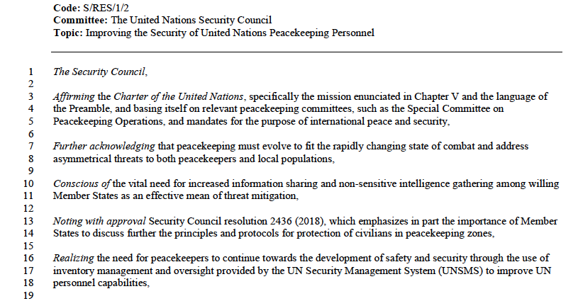
Working Paper – Preambular Clauses
Notes:
90601 CRN

Slide 14
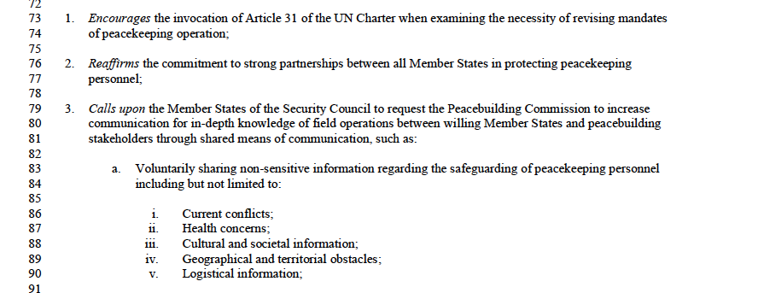
Working Paper – Operative Clauses
Notes:
90601 CRN

Slide 15
Working Paper Module
Activity 1:
Topic is Addressing the impact of climate change
Students individually write 1 preambular clause and 1 operative clause
Share clause and feedback
Activity 2:
Students get in groups of 4-5 and write 3 preambs and 3 operatives
Share clause and feedback
Notes:
90601 CRN

Slide 16
Reflection
What did you learn from the workshops? What are some important takeaways?
Do you think you are more prepared for conference?
Is MUN starting to make more sense?
Notes:
90601 CRN

