Slide 1
Model United Nations italymun workshops
Day 1
Cicognini High School
Notes:
90601 CRN

Slide 2
Today’s Outline
Introductions – me, you
Reflections about MUN
What is MUN?
Why MUN?
Parts of MUN
The United Nations – purpose, role, mandates, parts
Creating a research plan
Notes:
90601 CRN

Slide 3
Who am I?
Dr. Chris Haynes
Assistant Professor of Political Science at the University of New Haven
Director of Model United Nations
Personal Background
Grew up in Hawaii
Ethnicity - Japanese, German, Scottish
Educational Background
BA in Political Science, MBA from Texas Christian University
PHD in Political Science from University of California Riverside
Fellow at the Center for Comparative Immigration Studies
Notes:
90601 CRN

Slide 4
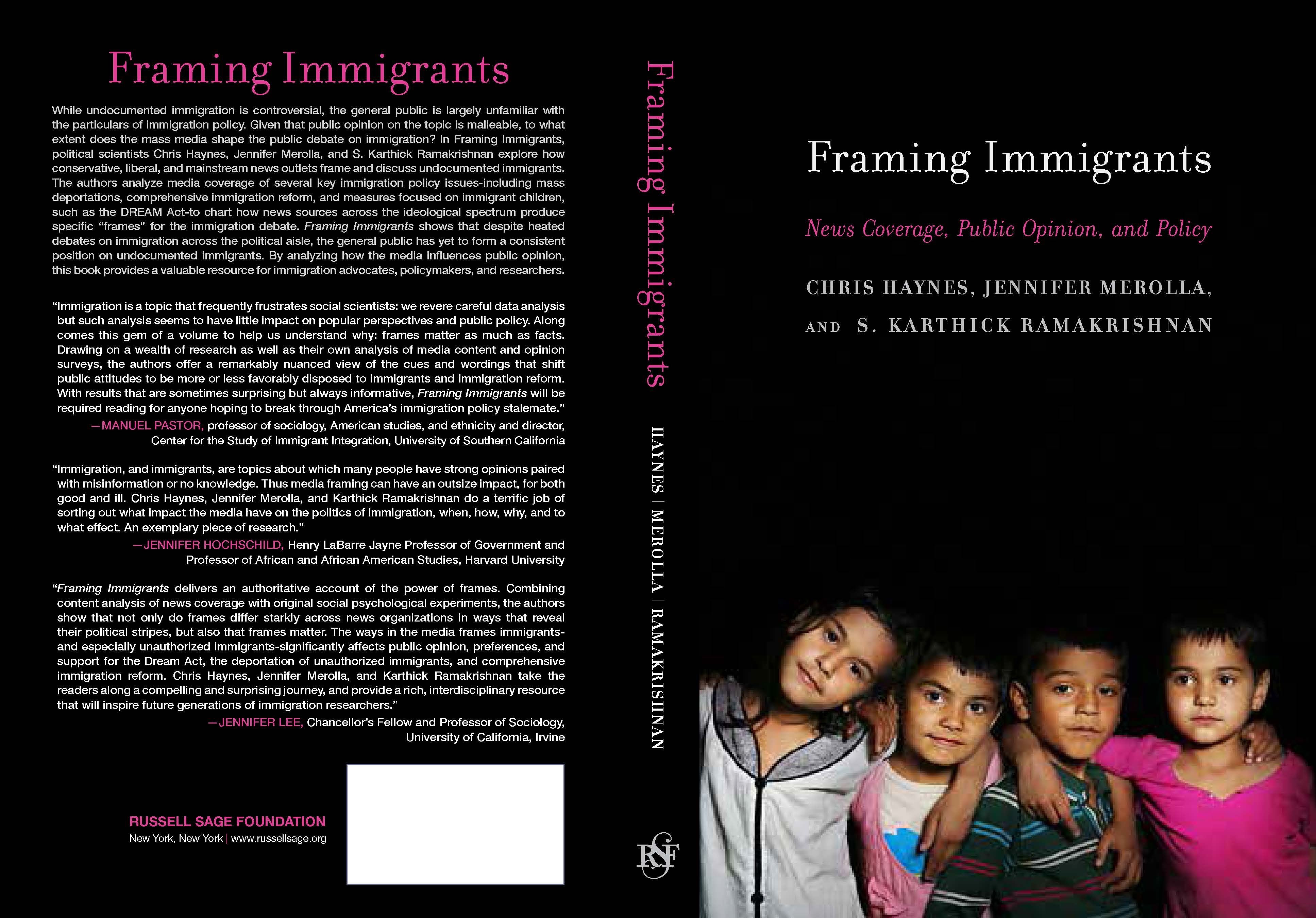
Who am I?
Research
Media framing and public opinion on immigration
Framing Immigrants: News Coverage, Public Opinion, & Policy (2016)
Illegal, Undocumented, or Unauthorized: Equivalency Frames, Issues Frames, and Public Opinion on Immigration (2013)
Social media effects
The Twitter Effect (2017)
Presidential coat tails
Is Loyalty is a Powerful Thing? Republican Senate Campaign Strategy and Trump Coattails in the 2016 Election (forthcoming in 2019)
Notes:
90601 CRN

Slide 5
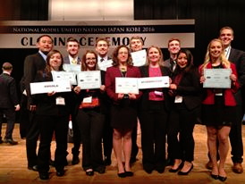
Who am I?
Model United Nations
Co-Director of MUN at UC-Riverside (2009-2011)
Attended annual NMUN conferences in New York & Washington D.C.
Program won multiple Outstanding Delegation, Outstanding Delegate, and Position Paper awards
Director of MUN at UNH (2014-present)
Created the MUN course in 2015
Attended annual NMUN conferences in Japan, Canada, China, New York, and Washington D.C.
Program won multiple Outstanding Delegation, Outstanding Delegate, and Position Paper awards
Successfully ran 2 ChargerMUN high school MUN conferences
Created high school Global Ambassadors program
Notes:
90601 CRN

Slide 6
Student Introductions
Name
Year/Grade
High School
What interested you about Model United Nations?
Something unique about you
Notes:
90601 CRN

Slide 7
Reflections About MUN
What is your past experience with MUN or simulation programs?
What would you like to attain from participation in MUN?
What are some of your fears or challenges?
Notes:
90601 CRN

Slide 8
What is MUN?
Model United Nations
Simulation that focuses on addressing international problems via multilateral diplomacy
Students are assigned a country to represent, a UN committee within which to work, & a particular global problem to address
Done in the context of a preparation period and a conference
Notes:
90601 CRN

Slide 9
What is MUN?
Example – Student 1
Represents France
Assigned to the Security Council committee
Addressing “Migration into Europe from Libya”
Notes:
90601 CRN

Slide 10
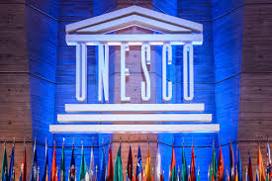
What is MUN?
Example – Student 2
Represents China
Assigned to the United Nations Education, Scientific, and Cultural Organization (UNESCO) committee
Addressing “Protecting and Preserving World Heritage Sites”
Notes:
90601 CRN

Slide 11
Why MUN?
Global Knowledge & Awareness
Learn about new countries & cultures, the United Nations, international relations and politics, Washington DC
Skill Development
Research, analytical writing, critical thinking, public speaking, conflict resolution, networking, communication
Personal Growth
Confidence, new friends, future job contacts, great for resume, potential letter of recommendation
Notes:
90601 CRN

Slide 12
Why MUN?
Resume builder
University admissions value MUN participation
Potential employers value it as well
You want to learn how to make a difference!
Notes:
90601 CRN

Slide 13
MUN Video
Fall 2018 DC MUN Thank you video

Slide 14
Prep Period - Research
Research the United Nations
Research the Committee
Research the Global Problem
Research the Country
Notes:
90601 CRN

Slide 15
Prep Period - Writing
Write a position paper
Background of the global problem
Country’s position on previous and future solutions to the global problem
Potential solutions to the global problem from country’s perspective
Writing a speech
States the importance of addressing the global problem
Explains why it is important
Proposes a potential solution to the problem
Notes:
90601 CRN

Slide 16
Prep Period – Learning the Conference Process
Conference in 60 seconds
Opening ceremonies
Begin committee meeting
Informal session – Breakout to discuss problem with other delegates
Formal session – Speeches, Motions, Moderated Caucus
Form groups of delegates
Create working papers
Submit/revise working papers
Working papers become draft resolutions
Vote on draft resolutions
Closing Ceremonies and Awards
Notes:
90601 CRN

Slide 17
The United Nations
Why was it created?
To preserve and promote peace in the post-WW II era
What is it?
Intergovernmental organization comprised of member states
What is its mandate?
Maintaining international peace and security
Protecting human rights
Delivering humanitarian aid
Promoting sustainable development
Upholding international law
Notes:
90601 CRN

Slide 18
The United Nations
What is it composed of?
Primary Organs
Security Council
General Assembly
Economic and Social Council
Trusteeship Council
International Court of Justice
General Secretariat
Related Organizations
UNHCR
IOM
UNESCO
WTO
Notes:
90601 CRN

Slide 19
The United Nations
Why does the UN matter?
Primary mode of multilateral diplomacy
Most significant problems are systematic and not confined to a specific region or set of countries
Problems are hard to solve if some players shirk
Has done a lot of good:
Peacekeeping
Alleviating poverty
Addressing health concerns
Providing a mechanism/forum to address climate change
Notes:
90601 CRN

Slide 20
Creating a Research Plan
You want to know the answers to 5 basic questions:
What is the topic/problem?
How has it been addressed in the past?
What is your country’s stance on this problem and its potential solutions?
What types of solutions are you able to mandate or propose as a member of your UN committee
What are some potential solutions to the problem?
Notes:
90601 CRN

Slide 21
Research Tools
Background guide from ItalyMUN
Research handout from UNH Librarian Joe Scollo
Targeted Google searches
Focusing on UN documents
Follow up citations within documents
Create a document listing the 5 questions and all information relevant that answers them
Notes:
90601 CRN

